Slide 1
HSS 102: History of Science
Instructors: Ritajyoti and Rajesh
Class 1
Approaching History of Science

Slide 2
What is History of Science (HoS)?
A Working Definition
The systematic study of the internal developments in science, viewing them as socio-cultural artefacts.
In other words, science is a human enterprise to study nature that shares bleeding boundaries with other social and cultural institutions such as the state, the church, the polity, and the economy. HoS studies transitions in science in conjunction with other institutions.
History in general, is more inclined to humankind. HoS pays attention to both humanity and the natural order of things. In most of the universities in Europe and the US, HoS is considered a separate discipline, and is often taught along with Philosophy of Science (PoS).
Professional Historians of Science learn science institutionally (and more typically up to the post-graduate level) and deploy historical methods and archival records such as biographies, correspondences, diaries, lab notes, government documents, court records, etc. [this is what you will be exposed to in this Course] to understand the complex relations between science and society.
Typically, a practitioner of science forgets about the discarded theories of the natural world. A historian of science, on the other hand, considers the waste-basket of science to be an archive of contested truth-claims. So, she makes you remember why and how you have forgotten certain issues and what the implications of such an institutionalized forgetting has in the making of the scientific community.

Slide 3
What does A HoS Course Intend to Achieve?
A course in the HoS invites a science student to ask fundamental questions about their approach and the achievements in sciences. It asks her to study science instead of doing it.
It asks you to question the self-evidence of the scientific community: A Historian of Science develops a strategic suspension of the taken for granted perceptions in the scientific community and offers a “stranger’s view” of science as opposed to the pre-existing “member’s view of science” (Shapin and Schaffer, 1985).
It advocates a set of “how” and “why” questions as opposed “what” and “who” questions.

Slide 4
Major Issues in HoS
Circulation of knowledge among civilizations over the centuries: Tracing encounters and emergence rather than origins [how do histories of science relate to its geographies?].
Institutionalization of science as a secular knowledge enterprise.
Conversations between internal developments in science and the external developments in society. A Historian of Science doesn’t always look for a neat match between scientific developments and the developments in the rest of the society. She also traces asymmetries and excesses, and considers them the ground zero of intervention.
Ethical implications of scientific research and its authority in shaping our collective future.

Slide 5
Major Episodes in the HoS (Modern Times)
The Scientific Revolution, The Chemical Revolution, The Conservation of Energy, The Darwinian Revolution, The Birth of Modern Biology and Genetics, Ecology and Environmentalism, The Birth and Hegemony of American Science, Physics in the 20th century, Revolutions in Cosmology, Climate Change, etc.

Slide 6
Themes in the HoS
The Organization of Science, Science and Religion, Popular Science, Vernacular Science, Science Policy, Science and Technology, Science and War, Science and Gender, The artisanal roots of science, histories of science institutions, Science and Ethics, etc.

Slide 7
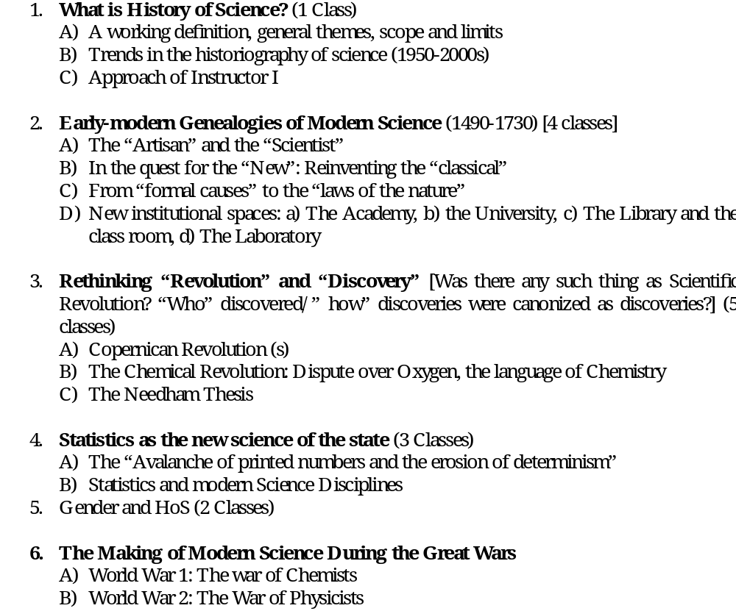
Themes that I wish to Cover

Slide 8
The Approach to be Taken
Play the role of the informed stranger among members and question the scientific community’s sacred self-evidence [Next slide---].
We hold, science is collectively practiced and historically embedded. So, while studying discoveries, we will be more interested to follow how discoveries are canonized as discoveries.
We will not study HoS by reading the biographies of a few great men. We are more interested in structures and processes than remarkable individuals.
We consider the sociological aspects of science to be internal and not just external to science.

Slide 9
Self-evidence and Its Problems
Self-evident statement: ‘any statement which, by putting synonyms for synonyms, is convertible into an instance of a logical form all of whose instances are true’ (Quine 1943, 120, cf. Douglas 1999, 253).
Example: ‘all bachelors are unmarried men’.
‘A self-evident statement is one which carries its evidence within itself’ (Douglas 1999, 253)>If a biology student at IISER Mohali is asked why she thinks that ostrich is a bird, her answer is likely to be that a) ostriches are just birds; b) Linnaean system of classification classifies ostriches as birds (Shapin and Schaffer 1985).
Member’s account of science runs the risk of self-evident method. I take the presuppositions of my own culture’s routine practices for granted without explanation and examination. Such presuppositions appear to me to be natural and normal ways of doing things (Shapin and Schaffer 1985).
They are guarded by powerful forces of convention and common-sense.

Slide 10
Works Cited
Douglas, M. 1972, 1999, Self-Evidence in Douglas, M. Implicit meanings: Select Essays in Anthropology, London, Routledge.
Shapin, S., S. Schaffer, 1985, Leviathan and the Air Pump: Hobbes, Boyle and the Experimental Culture, NJ, Princeton.

Slide 11
Next Class
Trends in the Historiography of Science.

